Slide 1
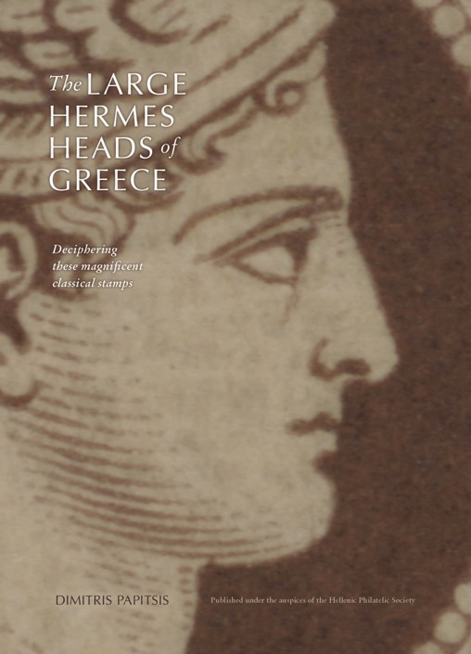
Presentation of the book:
The Large Hermes Heads of Greece
Deciphering These Magnificent Classical Stamps by
Dimitris Papitsis
Published under the auspices of the Hellenic Philatelic Society
Louis Fanchini - Balkanphila XX
Thessaloniki, November 13th, 2024

Slide 2
Agenda
What were the books used to classify the Large Hermes Heads so far?
The book
  The author
  The Dimitris Papitsis book presentation
  Conclusion
LHH Color chart by Stavros Andreadis
Complementary books & studies
  “Control Numbers” errors
  Plate flaws
  Plating
  Postmarks
  Postal History
  Forgeries
  Fabrication
  …

Slide 3
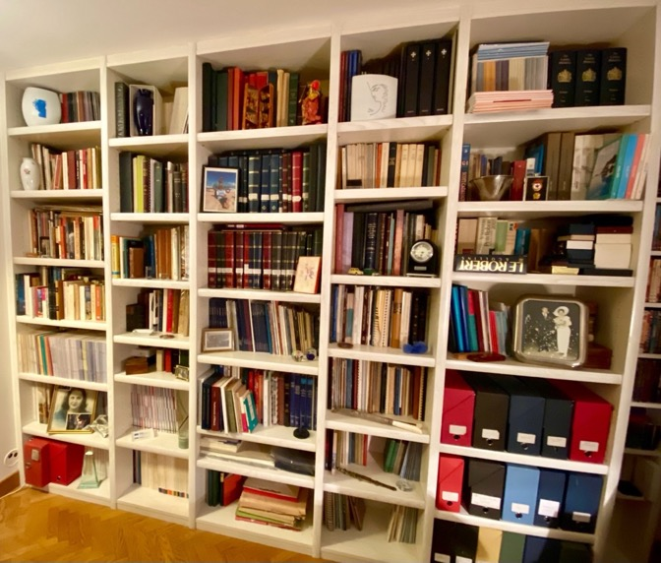
What were the books used to classify the Large Hermes Heads so far?
Large Hermes Heads stamps are probably one of the subjects which has generated the most ink in philately over time!
More than one third of my philatelic library is related to Large Hermes Heads, one way or another…
The majority of this literature is very specialized on targeted subjects (CNs, Plate flaws, Plating, Postal History, Forgeries, Fabrication…)
The Large Hermes Heads have the strong reputation to be difficult to classify and it’s often preventing philatelists to start collecting them...

Slide 4
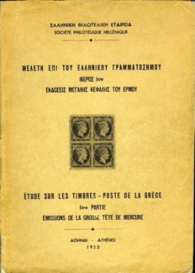

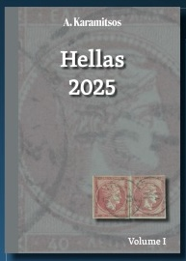
What were the books used to classify the Large Hermes Heads so far?
The “Etude” by Tryphon Constantinides published by the HPS of Athens in 1933, the “Bible”
The Hellas catalogues from Karamitsos auctions house (2000 to 2024 - Michael Tseriotis’ classification)

Slide 5
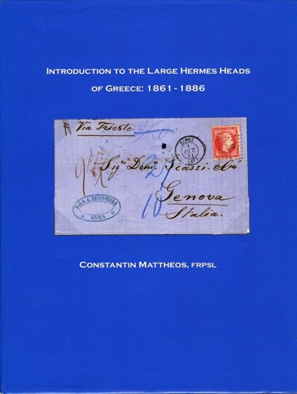
What were the books used to classify the Large Hermes Heads so far?
But the “Etude” is about a century old…
And the abundant other LHH literature is very often specialized…
One book has been published in 2011 by the RPSL, written by Constantin Mattheos:
INTRODUCTION TO THE LARGE HERMES HEADS OF GREECE: 1861 - 1886 (2011)
but it’s illustrated with some fake letters/new-papers on cover and inside…

Slide 6

What were the books used to classify the Large Hermes Heads so far?
One other small book has been published in 2019,
by Nikos Karniaoutakis:
Large Hermes Heads of Greece - Observations on Identifying and Classifying - The Easier to Follow Value (2019)
Available in Greek and English at the Lesvos Philatelic Society
So, an up-to-date generic book was really missing…

Slide 7
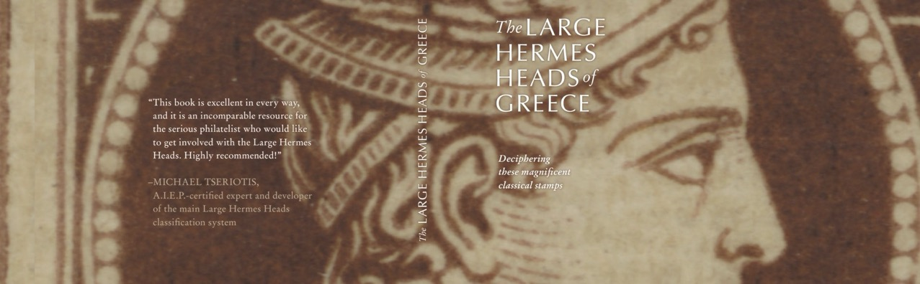
Now, the book

Slide 8

The Author
Dimitris Papitsis is a Greek philatelist
Living in the USA since more than 10 years and working in the high technology sector (software)
Passionate about LHH, he is bringing his understanding & practice of new technologies (publishing S/W, AI, databases, advanced scanning…) to the study and classification the Large Hermes Heads
He has already published several articles/studies on his work in Philotelia and has presented it through many video-conferences

Slide 9

The Large Hermes Heads of Greece
Deciphering These Magnificent Classical Stamps by
Dimitris Papitsis
Published under the auspices of the Hellenic Philatelic Society

Slide 10
Agenda
How it started
Book presentation
Engaging the audience
Visual aids
Final tips & takeaways

Slide 11
How it started

Slide 12

Initially…
I initially wanted to translate Constantinides’ “Etude” (Study) to English, as a classification guide.
I was unaware that the Study had already been translated by the late Louis Basel.
Then, I turned to my notes…

Slide 13
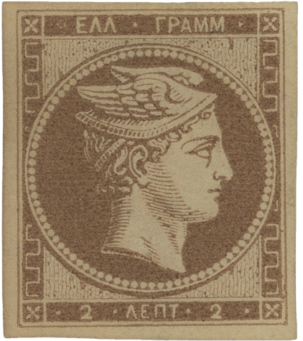
My notes
The book started as notes that I created based on different books and articles. The notes were needed:
  To have a compact knowledge source.
  Due to my limited memory capacity…
They had to be put in order and be written in Microsoft Word to be easily read and be searchable.
Their volume and my wish to share these notes with others helped create the book idea.

Slide 14

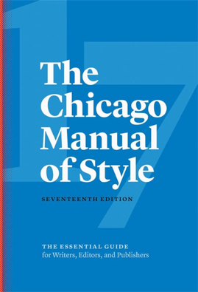


What tools were used
Desktop publishing, typography, grammar & syntax

Slide 15
Book presentation
Typography - software
Language - grammar and syntax
The book had to be presentable, not just a bunch of notes thrown into a Word document. As such, the decision was made to use advanced desktop publishing software.
Initial work on Microsoft Word, later page setting in Adobe InDesign
Word is better (=easier) when a lot of text is present.
InDesign is better in text organization (columns, spreads etc.), photo placing, color reproduction.
Written following the Chicago Manual of Style book recommendations and (most) typography standards.
Used tools (Grammarly) that enhance the quality of the text - (paraphrasing, grammar/syntax checking.)
A painstaking review was done during authoring, after content lock, and at publication, mostly by Demos Iskos.

Slide 16
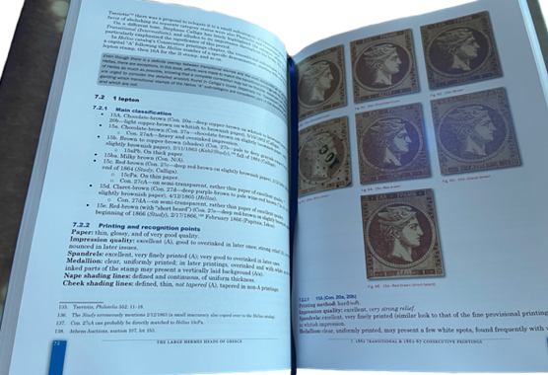
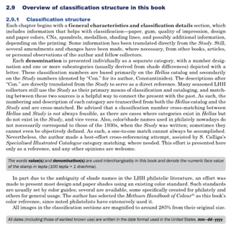
How it is structured

Slide 17
Book structure
Based on the Study and Hellas
Problems with existing bibliography
The book presents Large Hermes Heads per printing and then per denomination, which include:
General classification details per printing, using both the Study and Hellas classification methods
A sample image of one stamp per Hellas category
Classification points (including paper, shade, design details, varieties)
Images of interesting stamps and varieties at the end of each chapter.
There is some tribal knowledge.
Most is either written in Greek (old and new) and French, which are of no use to most collectors
Εither very outdated (Constantinides’ Study) or highly specialized
Most books/articles are difficult to find and read
A collector needs a significant time and money investment & persistence to gain knowledge. Thus:
A comprehensive LHH book in English was required.

Slide 18
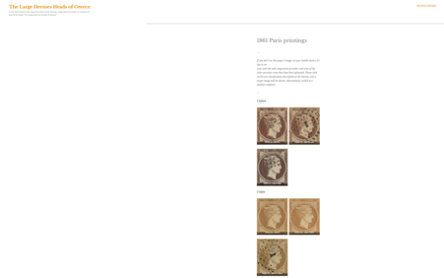

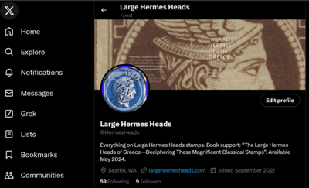
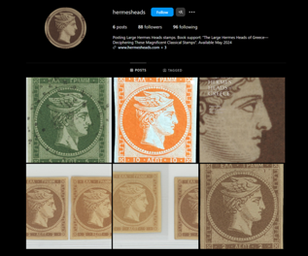


How it is supported
Web site
“X” account
Instagram
FB group

Slide 19
Book support
Web site
Social media
The book’s companion site is www.largehermesheads.com
It contains or will contain:
Online errata (errors found after publication).
All the book’s classification photos; or text, before being integrated to the next (2nd) edition of the book.
Explanations/analyses related to the book.
Each printing chapter has QR codes that lead to the web site’s relevant specific printing section.
Facebook group: Large Hermes Heads.
X (formerly Twitter) account: @HermesHeads.
Instagram account: @HermesHeads.
Printing characteristics
Printed on demand (vs offset printing).
Luxurious edition, full-color, hardbound, with dust jacket.
Printed with vibrant colors, on glossy paper, and with an integrated bookmark ribbon.
Priced at $99 (US & Canada) - available via eBay and Amazon.
Priced at 95€ (rest of the world) - available via HPS.

Slide 20
Book contributors
Reviews
Experts/friends/mentors/contributors
Demos Iskos
  Text review and changes
  Content review and changes
  Offered many identification-related photos
Michael Tesriotis, Kyriakos Papathanassiou, Louis Fanchini, Theofilos Salonidis - review
Nico Courtelis - cover, graphics, Hermes head design
Dr. Judge, Dr. Thompson - Colors chapter review.
Stephano Calliga
Panos Rassias
John Peristanoglou
Nikos Karniaoutakis
Hellenic Philatelic Society
Karamitsos auction house
Anthony Virvilis

Slide 21




Thank you
Dimitris Papitsis
info@hermesheads.com
http://www.hermesheads.com
http://www.largehermesheads.com
@HermesHeads
@HermesHeads
www.facebook.com/groups/hermesheadsbook

Slide 22
Conclusion
Deluxe 240 pages color hard-bounded book with high quality pictures using the last printing techniques, in English
Pictures & description of all the values of the 12 issues of the LHH (Michael Tseriotis) with the main “human” characteristics (colors, paper…) as well as advanced techniques for paper thickness or shades comparison…
Advanced classification using AI, with classification diagrams…
QR codes at each chapter lead to the web site (www.largehermesheads.com) which delivers magnified HD pictures and makes this “book” a platform for the future as it is:
  Evolutive
  Collaborative
  Interactive
  Scalable
A perfect introduction to all the subtilities of the LHH, including the literature related to:
    “Control Numbers” errors
    Plate flaws
    Plating
    Postmarks
    Postal History
    Forgeries
    Fabrication
    …

Slide 23
Conclusion
With this book, we are entering in a new era, using the most advanced technologies for building the content and publishing it
The perfect entry-point for new LHH collectors
A faithful companion for the advanced LHH afficionados
I am sure this book is a first brick a nice journey to come…
In one word:
OUTSTANDING!

Slide 24
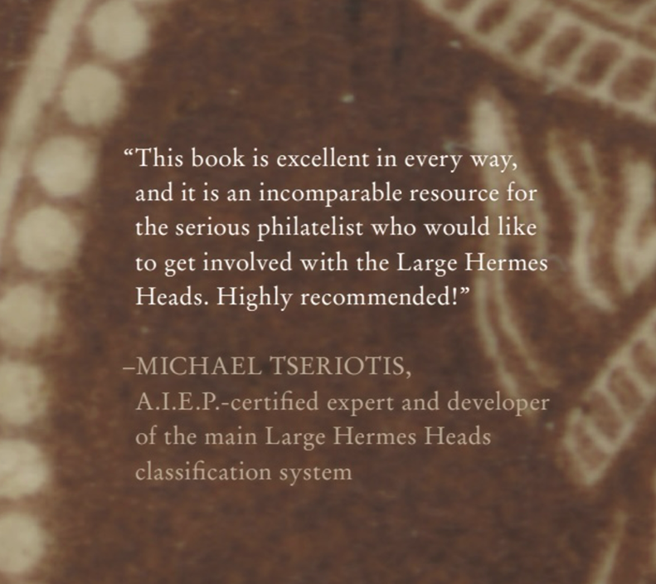
Conclusion

Slide 25
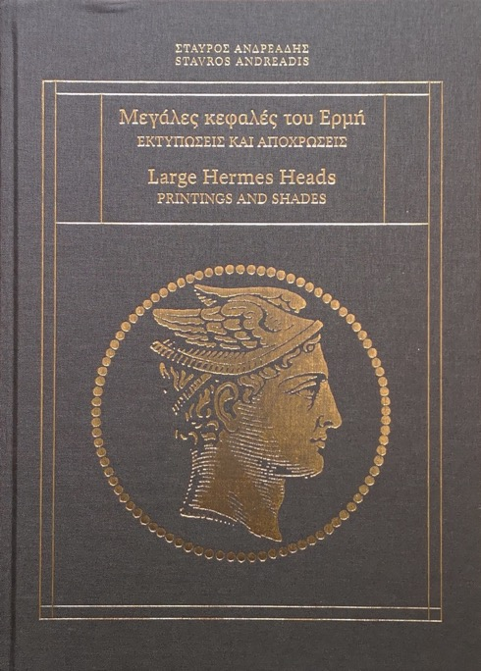
Complementary book
  LHH Color chart by Stavros Andreadis
  Large Hermes Heads - PRINTING AND SHADES (2024)
  For each color shade of all the values in the 12 issues of the Hellas catalogue, up to 5 high-resolution photographs (350 lpi), front & back
  Offered in large format (X 1.5). A total of 1,144 different shades are listed in this 160-page book.
  The text is in Greek and in English.
  Available from Karamitsos auctions house online shop www.karamitsos.com.
  The perfect complementary book to the Dimitris Papitsis one!

Slide 26
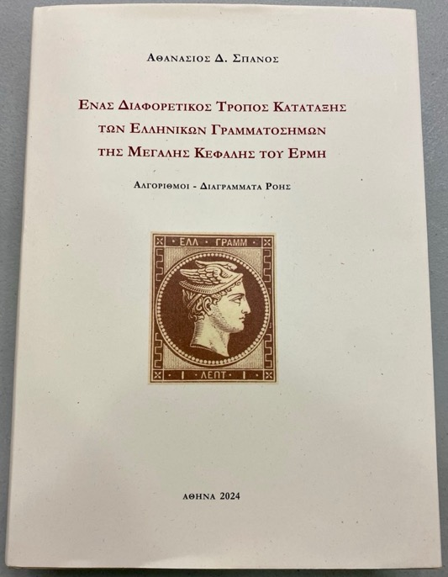
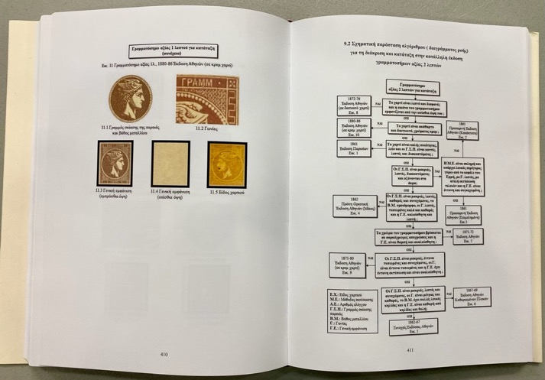
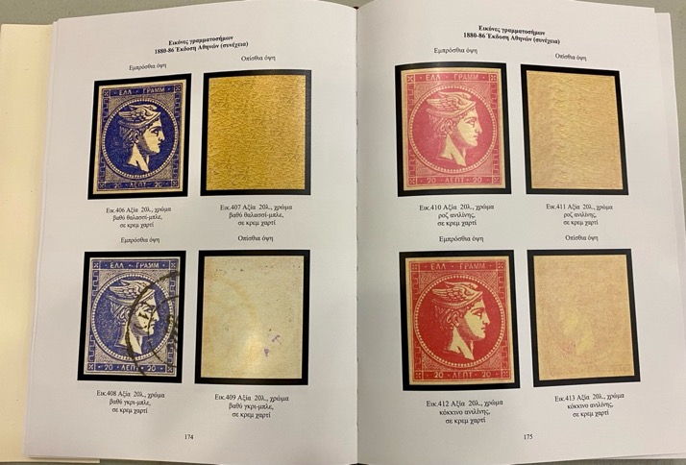
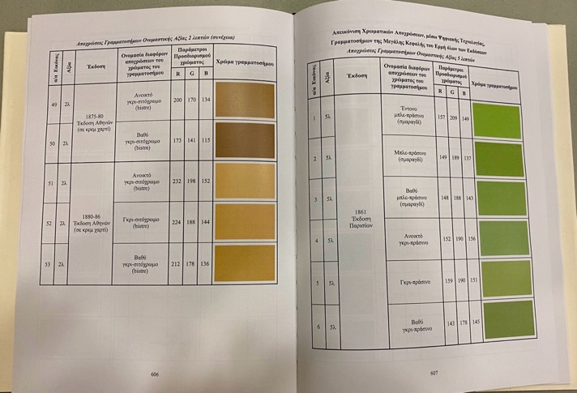
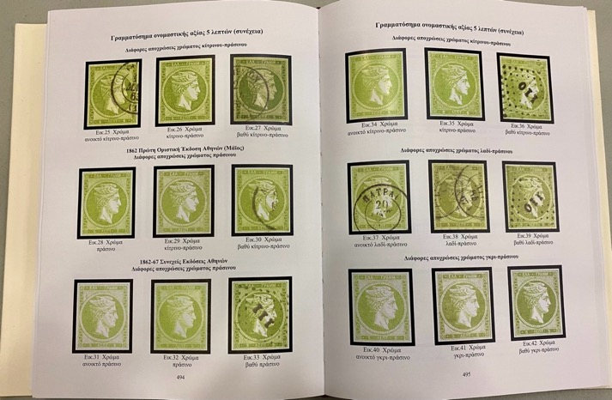
A yesterday discovery…
  LHH Book & Color chart by Athanasios D. Spanos
  Another way of classifying the stamps of the Large Hermes Heads of Greece (2024)
  718 pages (!)
  In Greek
  Numerous color illustrations
  Many diagrams, color charts…
  A 30 years work…

Slide 27
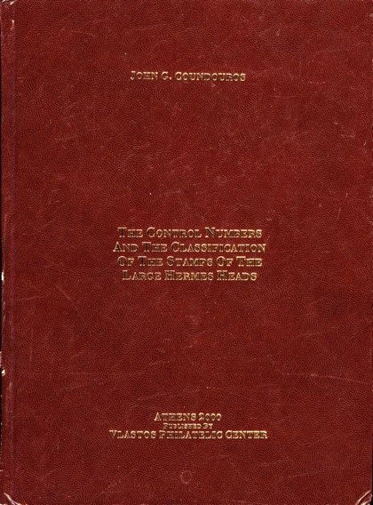
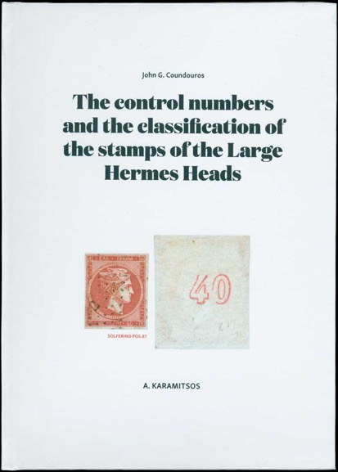
Specialized books
  If you wish to dig on the “control numbers” errors:
  Giannis (John) Coundouros’ books
  THE CONTROL NUMBERS AND THE CLASSIFICATION OF THE STAMPS OF THE LARGE HERMES HEADS (2000 & 2016)
  The text is in Greek or in English.
  Available from Argyris Karamitsos' online shop www.karamitsos.com.

Slide 28
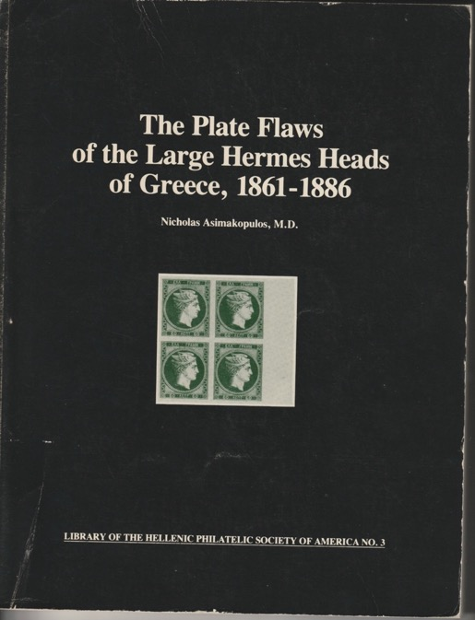
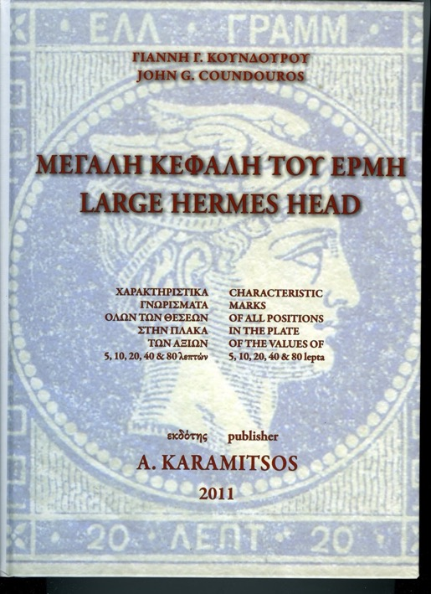
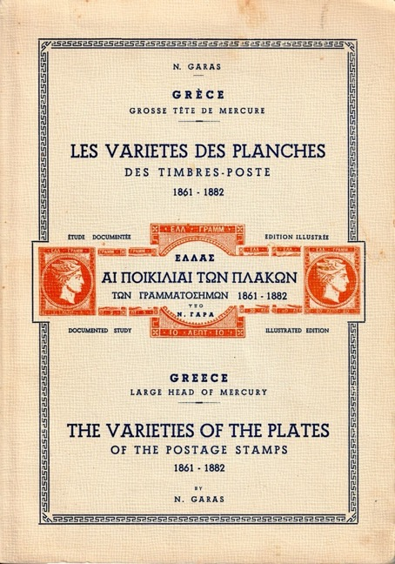
Specialized books
  If you wish to dig on the plate flaws:
  Nikolaos Garas’ book
  THE VARIETIES OF THE PLATES OF THE POSTAGE STAMPS 1861-1866 (1955)
  In Greek, English and French (but very difficult to find…)
  Nikos Asymakopulos’ book
  The Plate Flaws of the Large Hermes Heads of Greece, 1861-1886 (1995)
  In Greek or English
  Available from Argyris Karamitsos' online shop www.karamitsos.com
  Giannis (John) Coundouros book
  LARGE HERMES HEAD
  CHARACTERIOSTICS MARKS OF ALL POSITION IN THE PLATES OF THE VALUES OF 5, 10, 20, 40 & 80 lepta (2011)
  In Greek or English
  Available from Argyris Karamitsos' online shop www.karamitsos.com

Slide 29

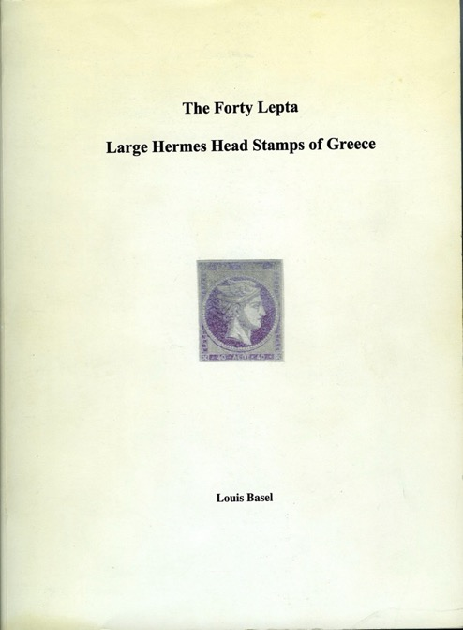
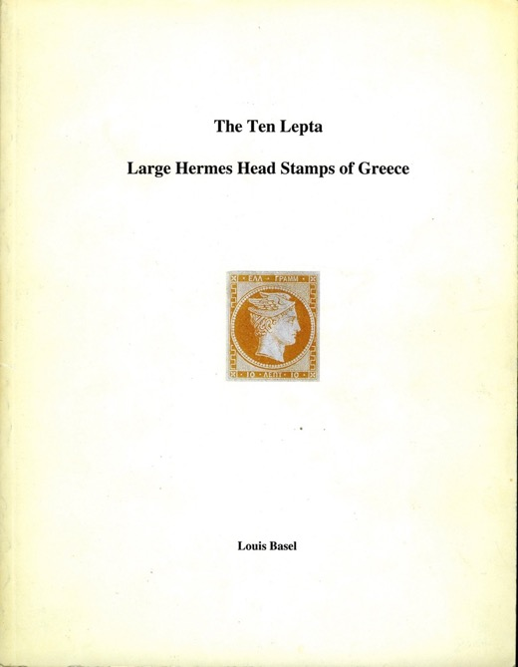
Specialized books
  If you wish to dig on the plating:
  Ulysse Bellas’ book
  LA TÊTE DE MERCURE - GENERALITES & RECONSTITUTION de la PLANCHE des 20 LEPTA (1978)
  In French (but very difficult to find…)
  Louis Basel’ books (In English)
    The Ten Lepta Large Hermes Head of Greece (2001)
    The Forty Lepta Large Hermes Head of Greece (2004)

Slide 30
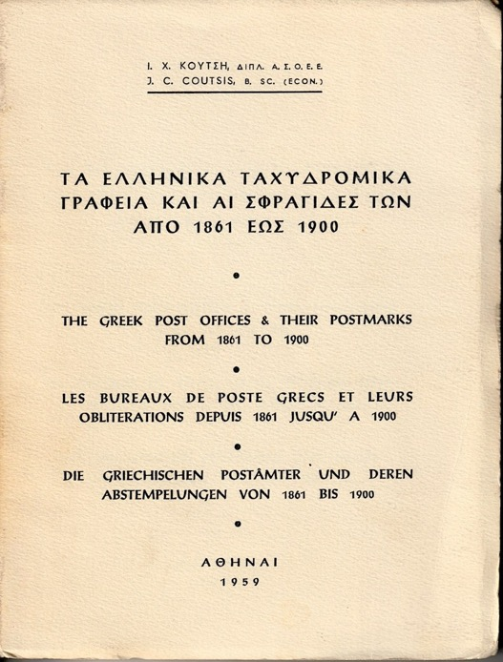
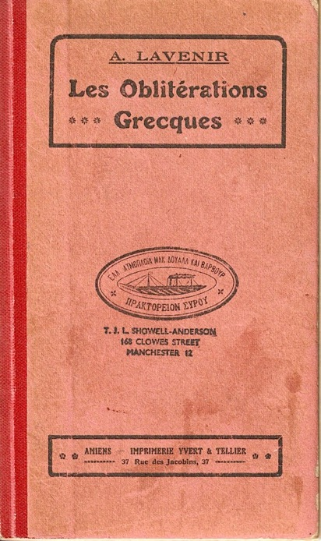
Specialized books
  If you wish to dig on the Postmarks:
  A. Lavenir’ book
  Les Oblitérations Grecques (1916)
  In French (but very difficult to find…)
  J. C. Coutsis’ book
  LES BUREAUX DE POSTE GRECS ET LEURS OBLITERATIONS DEPUIS 1861 JUSQU’A 1900 (1959)
  In Greek, English, French & German
  Available at Alexandre Galinos web site: https://collectio.bid

Slide 31
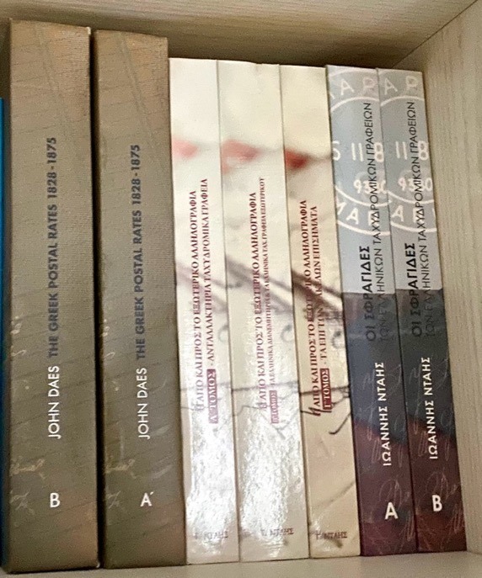

Specialized books
  If you wish to dig on the postal history:
  Michèle Chauvet’ book
  LES TARIFS HELLENIQUES DES LETTRES INTERNATIONALES 1861-1878 (2015)
  In French
  Available at JF Brun web site - https://jfbphilatelie.com
  Giannis (John) Daes’ books
  THE GREEK POSTAL RATES 1828 -1875
  (2012, 2019 & 2024)
  In Greek or English
  Yannis’ email: daisioannis@gmail.com

Slide 32
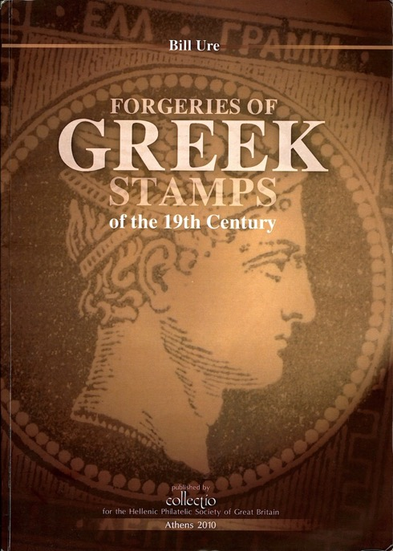
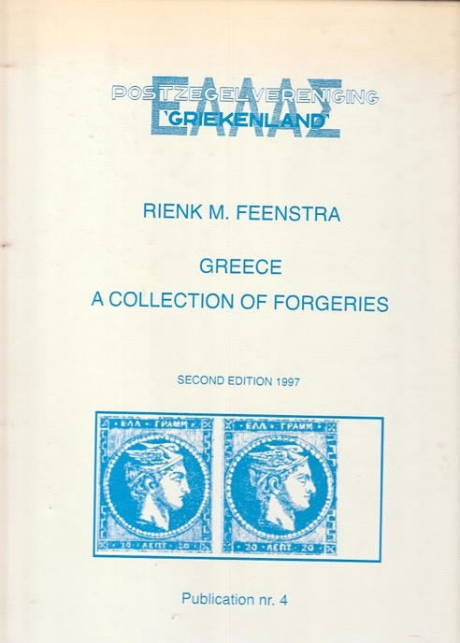
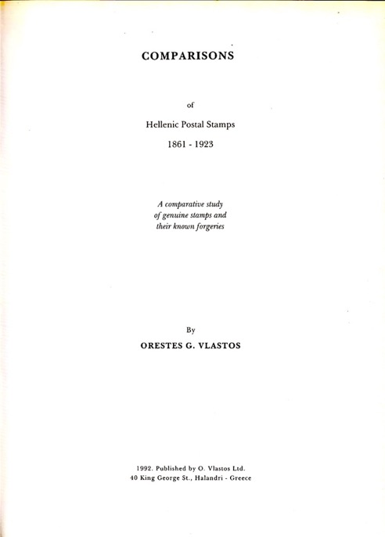
Specialized books
  If you wish to dig on the fakes & forgeries:
  Orestis G. Vlastos
  COMPARISONS of Hellenic Postal Stamps 1861 - 1923 (1992)
  In English (but very difficult to find…)
  Rienk M. Feenstra
  Greece - A COLLECTION OF FORGERIES (1997)
  In English
  Available on the HPS NL web site: https://pvgriekenland.nl/
  Bill Ure’ book
  FORGERIES OF GREEK STAMPS of the 19th century (2010)
  In English
  Available at Alexandre Galinos web site: https://collectio.bid

Slide 33

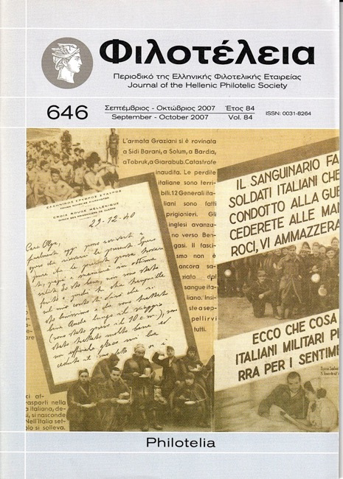
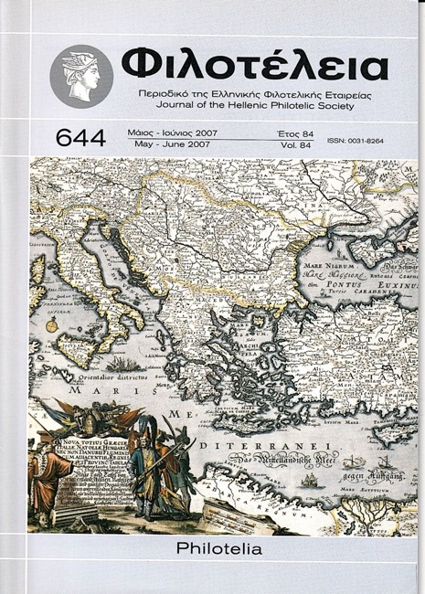
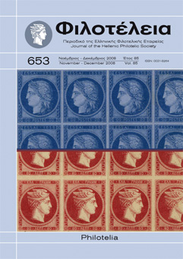
Specialized studies
  If you wish to dig on the fabrication:
  Louis Fanchini’s articles & studies in Philotelia (HPS) &
  OPUS (AEP annual publication)
  Available at HPS Athens web site:
  https://hps.gr/index.php/en/classic/
    On dies
    (HPS - Philotelia 669, 2011)
    On die & plate proofs definition
    (HPS - Philotelia 644, 2007)
    On typographic plates
    (HPS - Philotelia 652, 653 & 645, 2008 & 2009)
    On die-proofs & plate-proofs
    (HPS - Philotelia 650, 2008 & 669, 2011)
    On imprimatur
    (AEP - OPUS XIII, 2014)
    On Paris LHH quantities
    (HPS - Philotelia 646, 2007)

Slide 34
  Thank you for your attention!
  Questions?

